Slide 1
Web download Procedure
Steps to Perform Web download using LGST.
Steps to Perform Web download using PC Suite Software
Computer / Laptop Software upgrade Screenshots
Phone Software upgrade Screenshots
kenneth.jarapa@lge.com

Slide 2
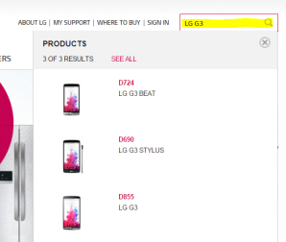
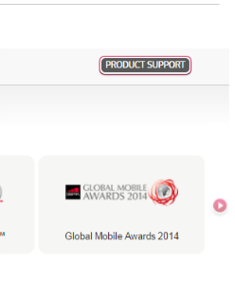
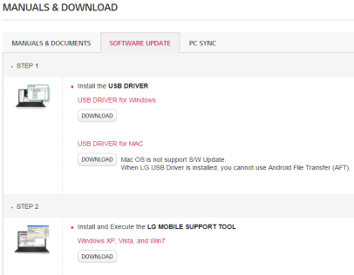
Steps to Perform Web download using LG Software Upgrade Tool [ LGST ]
Download LGST tool
To download LG Support Tool, go to Browser , Open http://www.lg.com/ph
On search bar, input the model name or model number (e.g. LG G2, LG D855, etc.) . [ Check if your model is available in the list , else pick from the latest model available in the dropdown ]
Scroll down , Select Product Support .
Download and install USB DRIVER and LG MOBILE SUPPORT TOOL

Slide 3
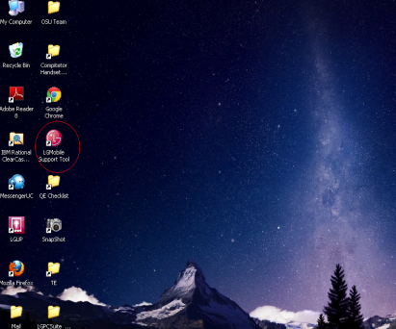
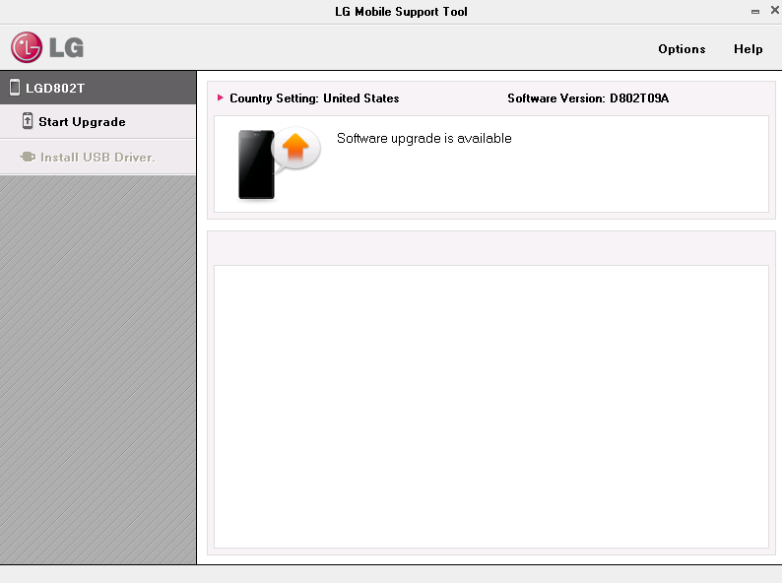
Steps to Perform Web download using LG Software Upgrade Tool [ LGST ]
RUN LGST tool
Check for Update in LGST
5. Install LGST (LG Support Tool) .
6. Now Connect the Phone to PC [ Install required drivers for upgrade ]
7. Now Run LGST .
8. If New Software is available “ Software Upgrade is available “ with Start Upgrade soft key enabled .
9. Click “Start Upgrade “
Note: Same procedure is used for all models

Slide 4
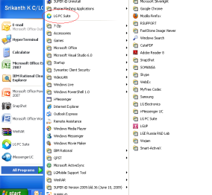
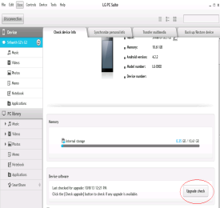
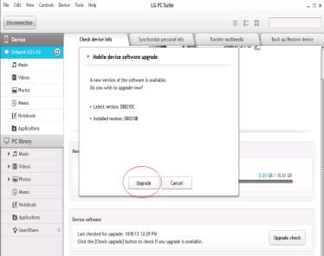
Steps to Perform Web download using PC Suite Software
Run PC Suite S/W
Launch PC Suite S/W
Check for new S/W availability
Install the latest PC suite Software that is supported for Model. Available also at http://www.lg.com/ph
Now Run the PC Suite installed in the PC .
Connect the Phone to PC
PC Suite will read the Phone details
Now Click on “Update Check “ button
If New Software is available “ Latest “ and “ Phone Flashed version “ will be displayed
Click on “Upgrade” button
Software upgrade Screen will displayed for upgrading the Phone.
Note: Same procedure is used for all models

Slide 5
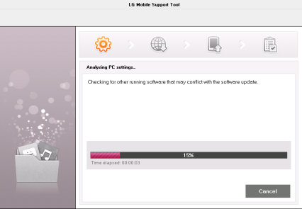
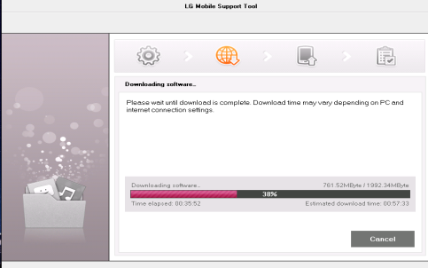
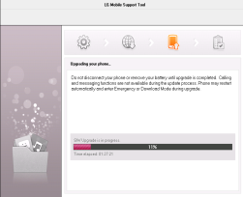
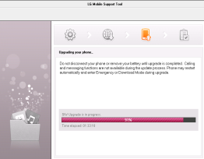
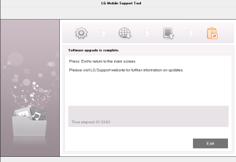
Computer / Laptop Software Upgrade Screenshots
Analysis Phase
Download Phase
Phone Firmware Update Phase
Software Update Completed

Slide 6
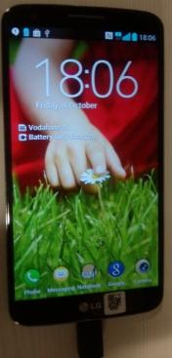
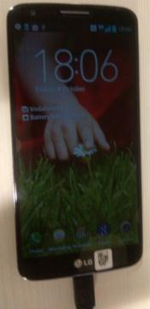
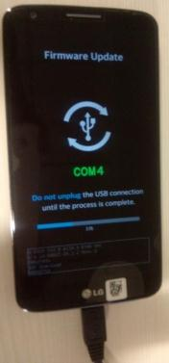
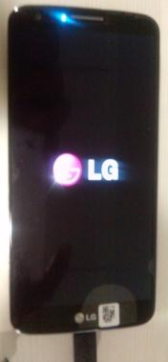
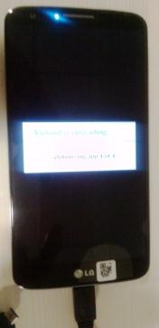
Phone Software upgrade Screenshots
Analysis Phase
Download Phase
Update Phase
Software update Completed
1. Analysis Phase : Phone IMEI ,Version , Model information is read by the LGST and same is communicated to LG Server
2. Download Phase : Phone Software is downloaded to PC
3. Update Phase : Phone Software is upgrading to the latest available version
4. Software update Complete Phase : Phone Software is updated to the latest version.
Note: Do not remove the connection of phone to PC until upgrade is complete.

Slide 7
声明：
所有的版权属于原有公司，文件均来自公开渠道
此文件仅供学习使用，任何人不得进行以此为商业目的的行为
如有疑问，请立即删除
学习世界五百强和咨询公司PPT课程请访问如下网站搜索：“司马懿”
百度传课：司马懿PPT学校
https://www.chuanke.com
网易学堂：司马懿PPT学校
https://study.163.com
知乎： 司马懿PPT学校
https://www.zhiu.com

